Slide 1
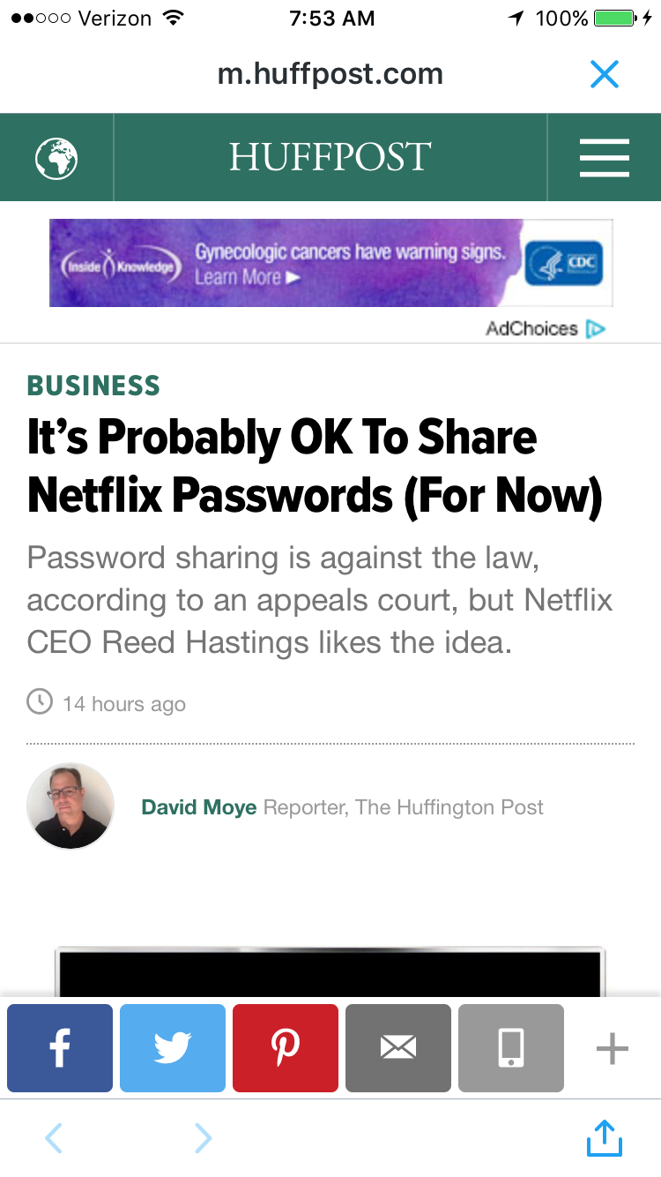
ADD YOUR LOGO HERE
CASE STUDY
Template Here
TARGET THE RIGHT CONSUMERS
Insert Creative Here
Client Objectives
Customer Name was seeking the most effective way to let their customers know about XYZ.
Solution
Our solution was to use primis in faucibus orci luctus et ultrices posuere cubilia Curae; Donec velit neque, auctor sit amet aliquam vel, ullamcorper sit amet ligula. Curabitur non nulla sit amet nisl tempus convallis quis ac lectus. Curabitur arcu erat, accumsan id imperdiet et, porttitor at sem.
1,234,567
12,345
1.23%
Impressions Served
Total Clicks
Click-Through Rate (320x480)

